Slide 1
Employee Data Analysis using Excel
STUDENT NAME : KEERTHANA S
REGISTER NO : 312216963
DEPARTMENT: BCOM (GENERAL )
COLLEGE :SHRI KRISHNASWMY COLLEGE FOR WOMEN

Slide 2
PROJECT TITLE
Salary and compensation analysis through excel data modelling

Slide 3


AGENDA
Problem Statement
Project Overview
End Users
Our Solution and Proposition
Dataset Description
Modelling Approach
Results and Discussion
Conclusion
3/21/2024 Annual Review

Slide 4

PROBLEM STATEMENT
1. Internal equity : Pay disparities among employees in similar roles and departments.
2. External competitiveness : Salaries not aligned with industry standards, impacting recruitment and retention.
3. Budget constraints : limited funds for salary increases, requiring optimal allocation.
4. Performance-based pay : Ineffective linking of salaries to employee performance and contributions.
5. Data-driven decisions : Lack of robust data analysis to inform salary adjustments and compensation planning.

Slide 5

PROJECT OVERVIEW
Project Objective :
- Develop a comprehensive Excel data model to analyze and optimize ABC Corporation's salary and compensation structure.
- Identify pay disparities, align salaries with industry standards, and design a performance-based pay structure.
- Inform data-driven decisions to drive business outcomes, employee motivation, and retention.
Scope :
- Salary and compensation data for 500 employees
- Industry benchmark data for salary ranges and compensation trends
- Company financial data for budget constraints and revenue growth
- Excel data modeling, analysis, and visualization
- Recommendations for salary adjustments, performance-based pay, and compensation planning
.

Slide 6

WHO ARE THE END USERS?
1. HR Department : HR professionals will use the analysis to inform compensation decisions, identify pay disparities, and design performance-based pay structures.
2. Finance Department : Financial analysts will utilize the analysis to understand budget implications, allocate resources, and ensure compliance with financial regulations.
3. Management Team : Managers will rely on the analysis to make informed decisions about employee compensation, performance management, and talent retention.
4. Compensation and Benefits Team : This team will use the analysis to design and implement competitive compensation packages, benefits, and incentives.
5. Business Leaders : CEOs, CFOs, and other business leaders will use the analysis to drive strategic decisions about talent management, budget allocation, and business growth.
6. Employees (Indirectly): While employees won't directly use the analysis, they'll benefit from fair and competitive compensation, performance-based incentives, and improved benefits.
These end users will benefit from the insights and recommendations generated by the salary and compensation analysis, enabling data-driven decisions to drive business outcomes, employee motivation, and retention.

Slide 7

OUR SOLUTION AND ITS VALUE PROPOSITION
Our solution :
- Comprehensive salary and compensation analysis through Excel data modeling
- Integrates employee, industry, and company data
- Advanced analytics and data visualization
- Actionable recommendations for optimization
Value proposition :
- Data-driven compensation decisions
- Improved internal equity and external competitiveness
- Increased efficiency and cost savings
- Enhanced employee engagement and retention
- Compliance with regulatory requirements
Our solution empowers organizations to make informed compensation decisions, optimize their compensation structure, and drive business success.

Slide 8
Dataset Description
Employee Data : 500 employee records with attributes like:
- Job Title
- Department
- Location
- Salary
- Benefits
- Performance Ratings
- Industry Benchmark Data : Salary ranges and compensation trends for similar industries and roles
- Conpany Financial Data : Budget constraints, revenue growth, and cost of living adjustments
_Data Format:_
- Excel spreadsheets with structured data
- CSV files for easy import and analysis
_Data Purpose:_
- Analyze and optimize salary and compensation structure
- Identify pay disparities and areas for improvement
- Inform data-driven decisions for HR, Finance, and Management

Slide 9

THE "WOW" IN OUR SOLUTION
1. Comprehensive 360-degree analysis
2. Actionable insights for data-driven decisions
3. Customizable and scalable Excel data model
4. Cost-effective optimization of compensation spend
5. Enhanced employee engagement and retention
6. Ensures regulatory compliance
Our solution's WOW factors deliver a powerful, tailored, and actionable approach to salary and compensation analysis, driving business success and employee satisfaction.
3/21/2024 Annual Review
9

Slide 10
MODELLING
Data Modeling :
1. Data Integration : Combine employee, industry, and company data.
2. Data Transformation : Clean, format, and structure data for analysis.
3. Data Analysis : Apply advanced analytics and statistical techniques.
4 .Data Visualization : Create interactive dashboards and reports.
5. Data Insights : Identify trends, disparities, and areas for improvement.
Model Components :
1. Employee Data Table
2. Industry Benchmark Table
3. Company Financial Table
4. Compensation Analysis Worksheet
5. Data Visualization Dashboard
This concise data modeling approach enables a comprehensive salary and compensation analysis, driving informed decisions and business success.
10

Slide 11
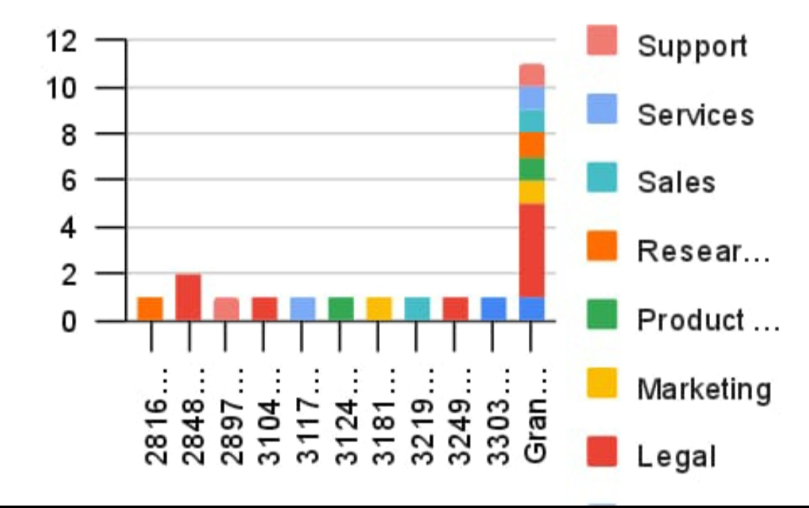
RESULTS
11

Slide 12
conclusion
Our salary and compensation analysis through Excel data modeling provides a comprehensive, data-driven approach to optimizing compensation structures. By leveraging advanced analytics and data visualization, organizations can:
- Ensure internal equity and external competitiveness
- Inform data-driven decisions
- Optimize compensation spend
- Enhance employee engagement and retention
- Ensure compliance with regulatory requirements
This solution empowers HR, Finance, and Management to make strategic decisions, drive business success, and improve employee satisfaction.

